Slide 1



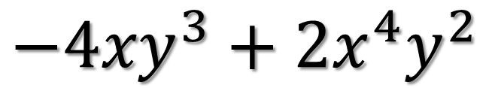
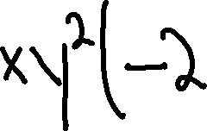

PDN
Find the error
$${−4xy}^{3}+2x^{4}y^{2}$$

Slide 2

Factoring trinomials
$${Ax}^{2}+Bx+C$$

Slide 3
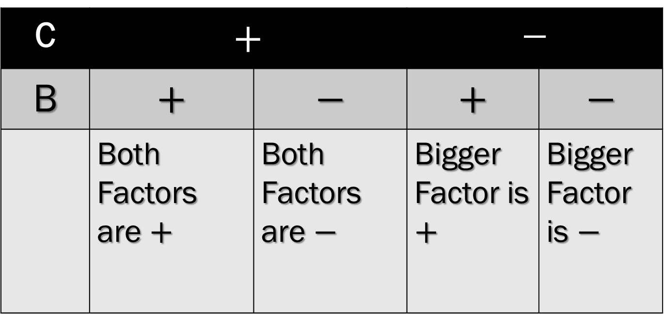
SIGN CHART
C | $$+$$ |  | $$−$$
B | $$+$$ | $$−$$ | $$+$$ | $$−$$
 | Both Factors are $+$ | Both Factors are $−$ | Bigger Factor is $+$ | Bigger Factor is $−$

Slide 4

SHORT CUT
$${Ax}^{2}+Bx+C$$
Write two sets of parenthesis,
( )( ). These will be the factors of the trinomial.
2. Think of factors of C that add up to
B. (Use Chart for Signs)

Slide 5
Example 1

Slide 6
Example 2

Slide 7
Example 3

Slide 8
Example 4

Slide 9
Example 5

Slide 10
Example 6

Slide 11

Try These
${1) x}^{2}+8x+12$
${2) x}^{2}−5x+6$
${3) z}^{2}+12z−28$
${4) x}^{2}−9x−22$

Slide 12
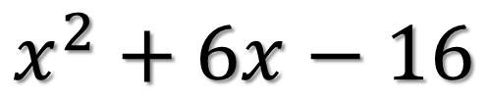
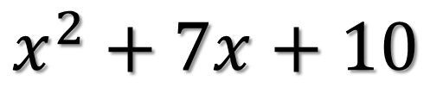
Ticket Out the Door
$$x^{2}+7x+10$$
$$x^{2}+6x−16$$
Rate yourself as +, -, or o.

